Slide 1



Traffic Light Simulation System Using C++
A Case Study in Real-Time System Simulation
Group No - 5

Slide 2


Introduction & Objective
Objective
Key Goals
To simulate a real-world traffic control system using C++.
Implement precise timing logic (Red → Green → Orange); create ASCII-based visual UI; demonstrate OOP in system design.

Slide 3
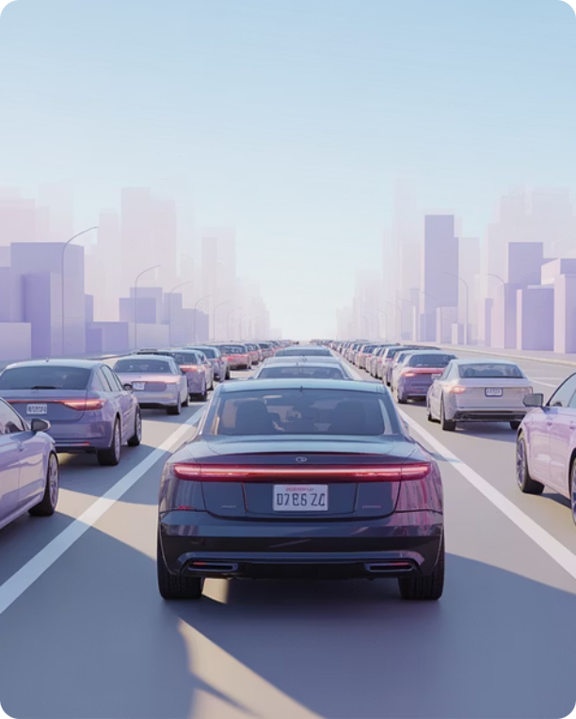
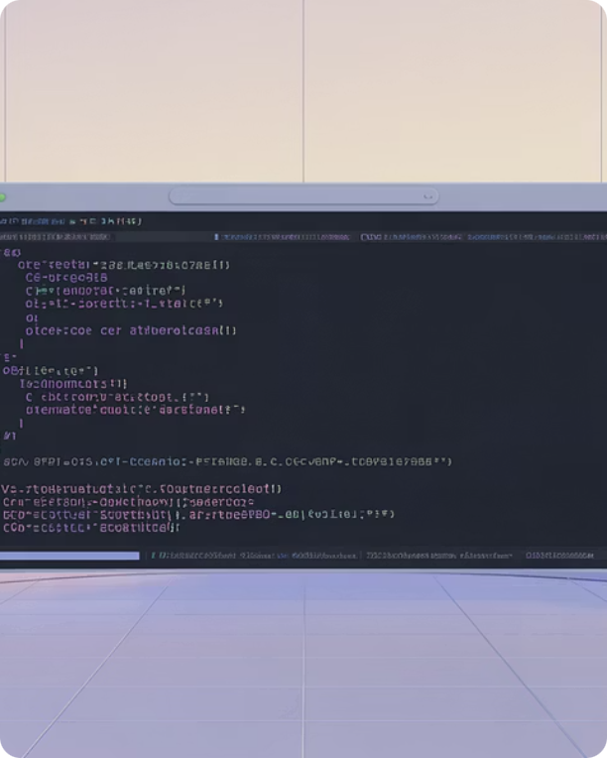

Problem Statement
The Challenge
The Solution
Real-world signals require robust state management and precise delays without freezing the system.
A C++ program using a state machine, multi-threading for delays, and dynamic console refresh (system(\"clear\")).

Slide 4
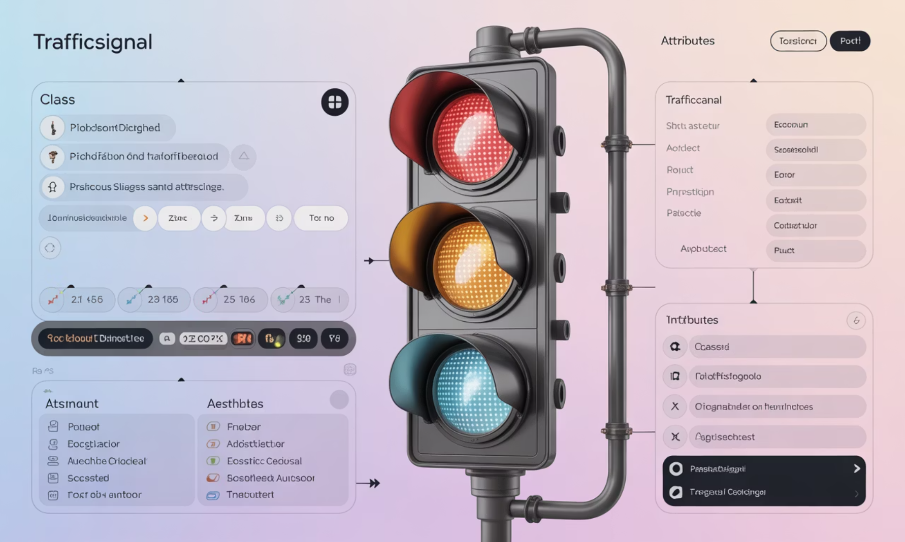


System Architecture — Class Design
Class: TrafficSignal
Encapsulates timing and behavior for the traffic light.
Attributes
redDuration, greenDuration, orangeDuration
Core Methods
drawGraphic() — renders the ASCII light; runPhase() — handles countdown; start() — cycles phases.

Slide 5
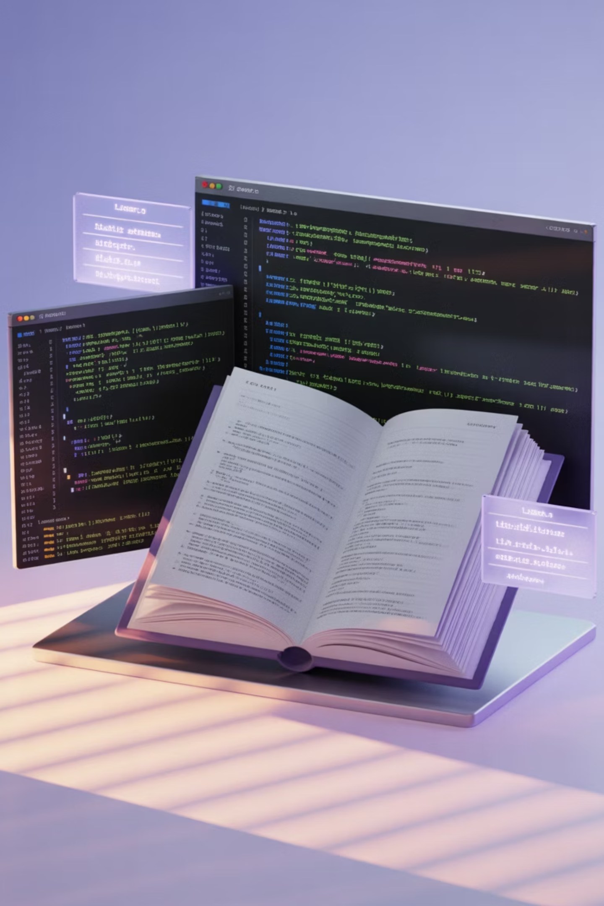





Key Technologies & Concepts
Language
C++ (Standard 11+)
Libraries
<iostream>, <thread> & <chrono>, <cstdlib>, <string>.
Features
ANSI escape codes for colored output; system(\"clear\") for dynamic UI updates.

Slide 6


Implementation Logic
Initialize TrafficSignal
RED Phase (draw + countdown)
ORANGE Phase (draw + countdown)
GREEN Phase (draw + countdown)
The program initializes a TrafficSignal object, runs phases in sequence (RED → GREEN → ORANGE), redraws the ASCII graphic each second, and loops indefinitely.

Slide 7
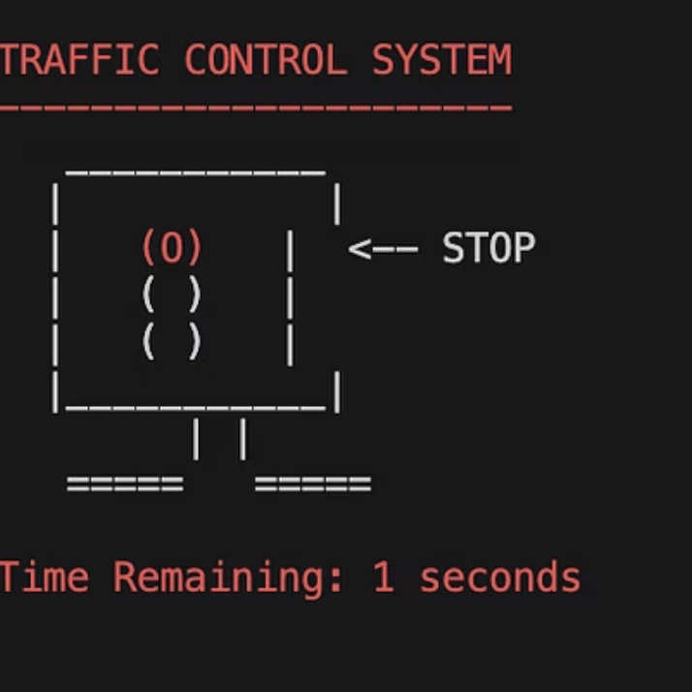
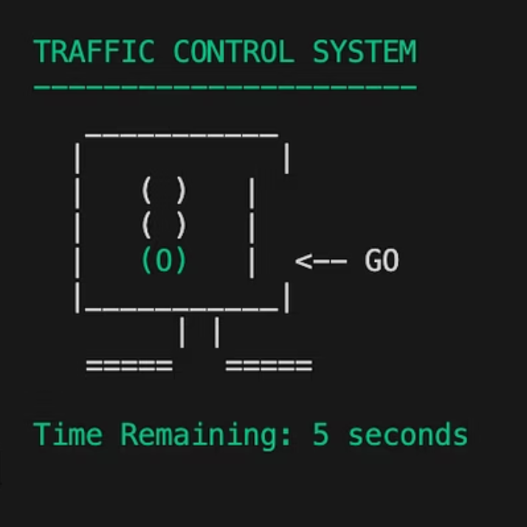

Simulation Output — Screenshots
Observation: The console clears and redraws every second, producing a smooth, animated effect rather than a scrolling log.

Slide 8


Why Our Simulation Stands Out
Industrial Logic
Visual User Experience
System Efficiency
We implemented a 'State Machine' architecture—the same logic used in real-world hardware controllers.
We solved the problem of static console text by creating a dynamic, flicker-free animation.
By using C++ Threading, our simulation runs with precise timing without freezing computer resources.

Slide 9


Thank You
Questions?
References
Bjarne Stroustrup, The C++ Programming Language
cplusplus.com — <thread> and <chrono> docs
GeeksforGeeks — C++ Classes and Objects
Standard C++ Foundation — ANSI color codes

